Slide 1
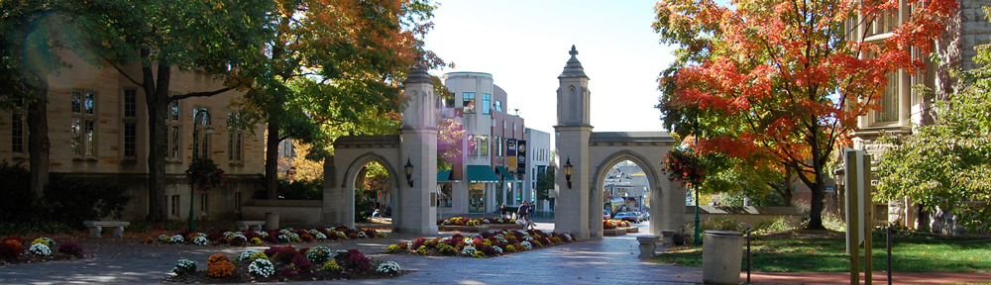
Secure Computation Pragmatics
Yan Huang
Indiana University
May 10, 2016

Slide 2
Menu
Develop efficient cryptographic protocols
  Library
  Compiler
  RAM computation
Applications
  Efficient circuits for ORAM
  Private edit distance over whole genomes
Oblivious computation in the RAM model

Slide 3
A Challenge in Programmability
Require many crypto primitives and optimizations
  Garbling
  Oblivious Transfer (OT)
  OT Extension
  Free-XOR
  Point-and-permute
  Garbled Row Reduction (GRR)
Error-prone

Slide 4
Extensible Library
App
AES
Edit-Distance
PSI
add
sub
mult
div
mux
cmp
Library
AND
XOR
OR
NOT

Slide 5
Example: add 1-bit
def add1bit(x, y, cin):
t1 = xor(x, cin)
t2 = xor(y, cin)
s = xor(x, t2)
t1 = and(t1, t2)
cout = xor(cin, t1)
return s,cout

Slide 6
Example: add n-bit numbers
def add(x, y, carry):
s = range(len(x))
t = carry
for i in range(len(x)):
s[i],t = add1bit(x[i], y[i], t)
return s

Slide 7
Write your own circuits/applications
Separation of Concerns
  No expert knowledge of crypto required
Modular construction
  Extend and reuse the circuit library
Compiler Support
  ObliVM [S&P’15]

Slide 8
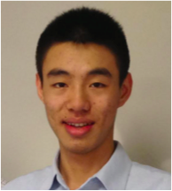
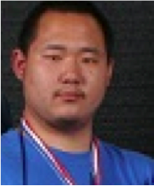

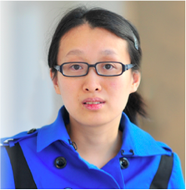

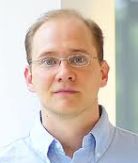
Compute things other than circuits?
Joint work with:
[LHSKH, Oakland’14]
[LWNHS, Oakland’15]

Slide 9
Binary Search
def binSearch(a, x):
lo, hi = 0, len(a)
res = -1
while lo <= hi:
mid = (lo+hi)//2
midval = a[mid]
if midval < x:
lo = mid+1
elif midval > x:
hi = mid
else:
res = mid
return res
Accessing a secret array using a secret index

Slide 10
Cryptographer’s favorite model
Programmer’s favorite model
AND
XOR
OR
i
…
…
M[i] = 20
…
Naïvely implemented using circuits: a linear scan

Slide 11
Oblivious-RAM to the Rescue
O-RAM
  Securely outsourcing storage
  Read(index), Write(index, value)
  Hide access patterns
  Poly-logarithmic cost per access
  [GO96, J. ACM], [WS08, CCS], [PR10, CRYPTO] [SSS12, NDSS], [SvSFRYD13, CCS]

Slide 12
ORAM -- Hiding Access Patterns
M
Untrusted
i
Trusted
ORAM Scheme
Read M[i]

Slide 13
ORAM -- Hiding Access Patterns
Hiding the index and the value
M
Untrusted
Trusted
ORAM Scheme
Read M[i]

Slide 14
Hiding the index and the value
M
Untrusted
Trusted
ORAM Scheme
Read M[i]

Slide 15
Hiding the index and the value
M
Read()
Write()
ORAM Scheme
Obliviously computed as circuits using
secure computation
Read M[i]
Untrusted
Trusted

Slide 16
Sensitive Control Flow
def binSearch(a, x):
lo, hi = 0, len(a)
i, res = log(hi), -1
while i >= 0:
i -= 1
mid = (lo+hi)//2
midval = a[mid]
if midval < x:
lo = mid+1
elif midval > x:
hi = mid
else:
res = mid
return res
Secret-dependent predicate

Slide 17
Handle Sensitive Conditionals
def binSearch(a, x):
lo, hi = 0, len(a)
i, res = log(hi), -1
while i >= 0:
i -= 1
mid = (lo+hi)//2
midval = a[mid]
if midval < x:
lo = mid+1
elif midval > x:
hi = mid
else:
res = mid
return res

Slide 18
Handle Sensitive Conditionals
if midval < x:
lo = mid+1
elif midval > x:
hi = mid
elif:
res = mid

Slide 19
Handle Sensitive Conditionals
elif midval > x:
ORAM Scheme
lo = mid+1
PC = nextInstruction()
res = mid
if midval < x:
hi = mid

Slide 20
Can we avoid retrieving instructions from ORAM?
if (a):
b = 10
else:
b = 12
b = mux(a, 10, 12)
if (a):
b = 10
b = mux(a, 10, b)

Slide 21
Avoid Putting Instructions in ORAM
Trace-oblivious program transformation
if (a):
a = x
else:
b = y
a = mux(a, x, a)
b = mux(a, b, y)
if (a):
a = x
elif (b):
b = y
else:
c = 0
t1 = a
t2 = (not a) and b
t3 = not (a or b)
a = mux(t1, x, a)
b = mux(t2, y, b)
c = mux(t3, 0, c)

Slide 22
Binary Search
def binSearch(a, x):
lo, hi = 0, len(a)
res = -1
while lo <= hi:
mid = (lo+hi)//2
midval = a[mid]
if midval < x:
lo = mid+1
elif midval > x:
hi = mid
else:
res = mid
return res

Slide 23
Removing Sensitive Control Flows
def binSearch(a, x):
lo, hi = 0, len(a)
i, res = log(hi), -1
while i >= 0:
i -= 1
mid = (lo+hi)//2
midval = a[mid]
c1 = midval < x
c2 = midval > x
c2 = midval == x
lo = mux (c1, mid+1, lo)
hi = mux (c2, mid, hi)
res = mux (c3, mid, res)
return res

Slide 24
Automation using a Compiler
Automatic Partition: variables are labeled with tokens
  secure, public, alice, bob
Automated Translation to memory- and trace-oblivious programs
Oblivious program abstractions: Map-Reduce, Richer library.

Slide 25
Savings (Binary search)

Slide 26
More Results
Knuth-Morris-Pratt String Matching
  20x speedup (search a 50-char pattern over a 2x10⁶-char string)
Dijkstra Shortest Distances
  100x speedup (graph size: 3500 nodes)

Slide 27
Savings (KMP-matching)

Slide 28
Savings (Dijkstra)

Slide 29

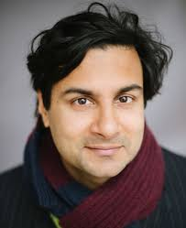
Garbled Computation of ORAM?
Joint work with:
[LHHSS, CCS’14]

Slide 30
Oblivious ORAM
Exhaustive Scan
Square Root ORAM
  [Goldreich-Ostrovsky, JACM’96]
Hierarchical ORAM
  [Goldreich-Ostrovsky, JACM’96]
Tree ORAM
  PathORAM, etc.
More on this later
in Dave’s lecture.

Slide 31
Tree based ORAM paradigm
[Shi et al. 11]
Bucket size: B
Server
Client

Slide 32
Main Invariant and Data Access
Path identified by leaf node l
l
x
Server
Client
l
Position map
x
Stash

Slide 33
Block x Must Now Relocate!
l
x
Server
Client
l
Position map
x
Stash

Slide 34
Data Access: Write back
New designated leaf node
r
Server
Update position map
Client
r
Position map
x
(x, r, data)
Stash

Slide 35
Eviction: percolate blocks up towards leaves subject to invariant
Server
Client
Conflicting Goals:
Less aggressive ==> Low cost
More aggressive ==> Smaller bucket size

Slide 36
Path ORAM Eviction
Server
Client
stash = stash + path
“aggressively” write back stash subject to invariant
Stash

Slide 37
Traditional ORAM Metrics
Bandwidth
Client storage
Computation
Round-trips
Server Storage

Slide 38
Metrics for SC-ORAM
Bandwidth
Computation
Client storage
Round-trips
Server Storage

Slide 39
Goal
Design a small eviction circuit and yet preserve its effectiveness.

Slide 40
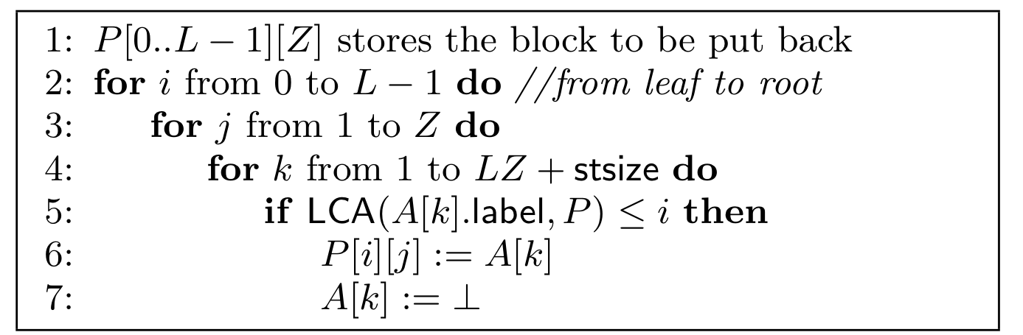
Path ORAM eviction
Most aggressive
A O(L²)-size circuit per eviction
A O(L logL)-size circuit per eviction
D: word size
N: number of words

Slide 41
Can we evict by scanning the path constant number of times?

Slide 42
SCORAM: heuristic approach:
Greedily push blocks upwards
Leaf
4
Not aggressive enough! Stash grows too quickly!
3
4
3
2
3
3
2
1
S
4
Stash

Slide 43
SCORAM: Reduce stash size by linear scan
Reverse dropping scan: put the deepest block in the stash to the deepest bucket in the path.

Slide 44
SCORAM: heuristic approach
Leaf
4
2-step eviction:
3
4
3
1) Reverse dropping scan:
Put the deepest element in stash
to the path as deep as possible
2) Greedy push scan:
Greedily push blocks down
2
3
3
2
1
S
4
Stash

Slide 45
SCORAM [CCS’14]
1GB data, each 32 bits
20X
10X

Slide 46

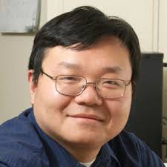
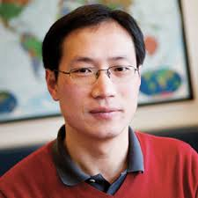
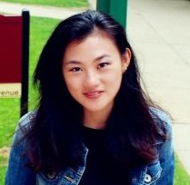
Private Edit Distance over Whole Genomes
Joint work with:
Yong’an Zhao
[WHZTWB, CCS’15]

Slide 47
Edit distance
Preferred metric for similarity of genomic data
  more relevant than Hamming distance
Generic Solution using Dynamic programming
  O(N²)
  Securely compare two genomes of lengths 2000 and 10000 nucleotides: 1.29 billion AND gates, 3.7 hours
  Human genomes have 3 billion nucleotides.
[HEKM, USENIX’11]

Slide 48
Summary of Results
  Compute edit distance on whole human genomes in 39 seconds (error: ≈2%).
  Similar breast-cancer patient query of 1000-patient database in < 8 minutes

Slide 49
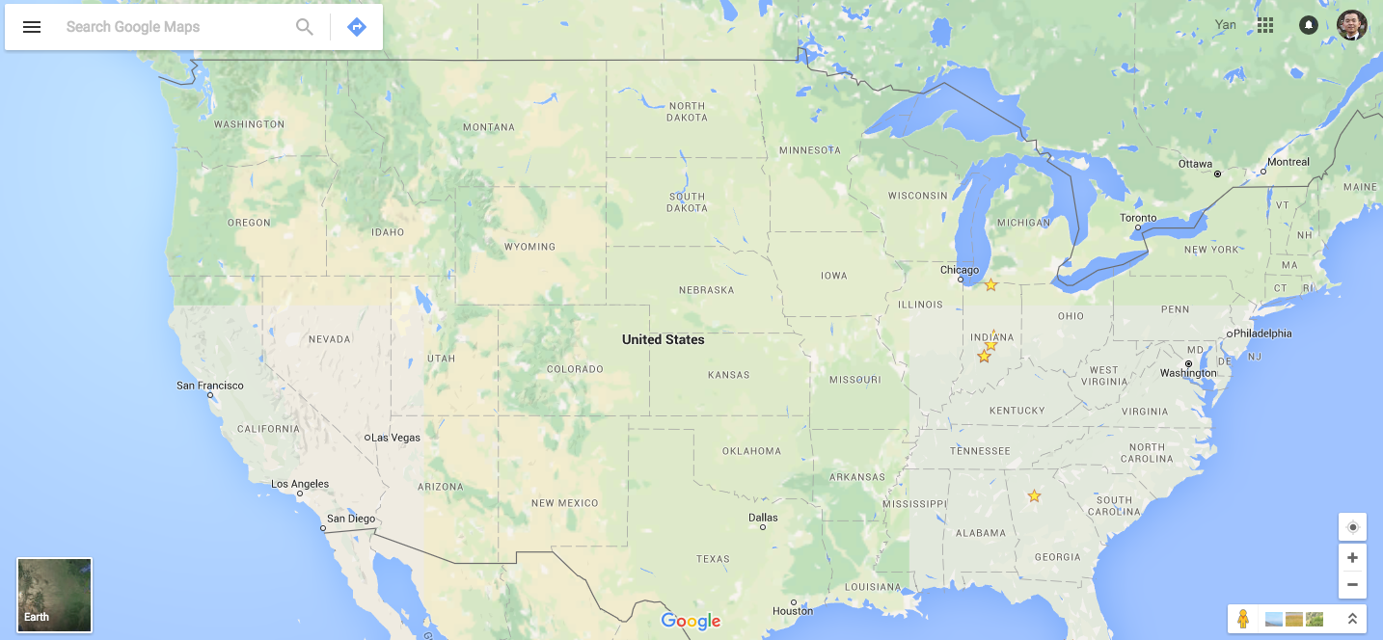
100 Mpbs
100 ms
Single core Garbler
Single core
Evaluator

Slide 50

Methodology Insights
Edit distance
Genomic
Characteristics
Set difference size
Sketch
Algorithm
Our protocols

Slide 51
Edit distance → Set difference size
PA = GTTGA T
Ref = ATTGACT
PB = GTT ACT
Edit distance = 2
Edit(P_{A}, Ref)=
{(1,SUB,G),(6,DEL,1)}
Edit(P_{B}, Ref)=
{(1,SUB,G),(4,DEL,1)}
Set difference size = 2

Slide 52
Edit distance → Set difference size
PA = GTTGAT
Ref = ATTGACT
PB = GTTGCT
Edit distance = 1
Edit(P_{A}, Ref)=
{(1,SUB,G),(6,DEL,1)}
Edit(P_{B}, Ref)=
{(1,SUB,G),(5,DEL,1)}
Set difference size = 2

Slide 53
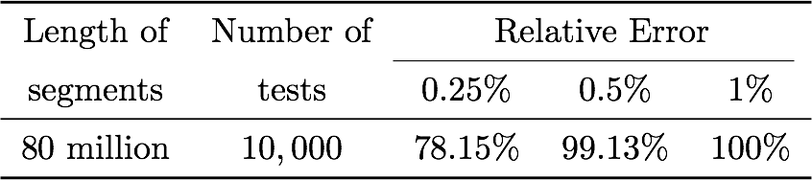
Effects
Most edits are substitutions;
Insertions are sparse.
Originally: edit distance, O(N²), N = 3 billion Nucleotides
Now: Set Intersection Size, O(N log N), N = 4 million “Edits”

Slide 54
Methodology Insights
Edit distance
Genomic
Characteristics
Set difference size
Sketch
Algorithm
Our protocols

Slide 55
Through Sketching Intersection Size?
|A-B|=|A|+|B|-2|A∩B|

Slide 56
By Sketching Intersection Size?
|A∩B|≈10000|A-B|
ε_{|A-B|}≈ 10000 ε_{|A∩B|}

Slide 57
Better Sketching Difference Size Directly
.
.
.
.
.
.
.
.
.
.
.
.
.
.
.
.
.
.
.
.
.
.
.
.
.
.
.
.
.
.
.
.
.
.
.
.
.
.
.
.
.
.
.
.
.
.
.
|A-B|

Slide 58
Basic Protocol: SketchDiffSize
Agree on randomness r, a hash function h() with range {1, -1}
Compute
Compute
Estimate set difference size using (dA - dB)²
Local
Secure

Slide 59
Example
h(r₁, ⋅)
h(r₁, ⋅)
(1,INS,A)
(10,DEL,1)
(11,SUB,A)
(20,INS,T)
-1
1
1
1
-1
-1
1
(2,INS,A)
(7,SUB,C)
(11,SUB,A)
2
-1
Local
Secure
(dA - dB)² =
(2-(-1))²=9
9

Slide 60
Example
h(r₂, ⋅)
h(r₂, ⋅)
(1,INS,A)
(10,DEL,1)
(11,SUB,A)
(20,INS,T)
1
-1
-1
1
1
-1
-1
(2,INS,A)
(7,SUB,C)
(11,SUB,A)
0
-1
Local
Secure
(dA - dB)² =
(0-(-1))² = 1
9
1
Mean
5

Slide 61
Example
h(r₃, ⋅)
h(r₃, ⋅)
(1,INS,A)
(10,DEL,1)
(11,SUB,A)
(20,INS,T)
1
1
1
-1
-1
1
-1
(2,INS,A)
(7,SUB,C)
(11,SUB,A)
1
-1
Local
Secure
(dA - dB)² =
(1-(-1))² = 4
9
1
4
Mean
5
4.7

Slide 62
Example
h(r₄, ⋅)
h(r₄, ⋅)
(1,INS,A)
(10,DEL,1)
(11,SUB,A)
(20,INS,T)
-1
-1
1
-1
-1
1
1
(2,INS,A)
(7,SUB,C)
(11,SUB,A)
-1
1
Local
Secure
(dA - dB)² =
(-1--1)² = 4
9
1
4
4
Mean
5
4.7
4.5

Slide 63
Example
h(r₅, ⋅)
h(r₅, ⋅)
(1,INS,A)
(10,DEL,1)
(11,SUB,A)
(20,INS,T)
1
1
1
1
1
-1
1
(2,INS,A)
(7,SUB,C)
(11,SUB,A)
-1
1
Local
Secure
(dA - dB)² =
(4-1)² = 9
9
1
4
4
9
Mean
5
4.7
4.5
5.4

Slide 64
Example
h(r₆, ⋅)
h(r₆, ⋅)
(1,INS,A)
(10,DEL,1)
(11,SUB,A)
(20,INS,T)
1
1
1
1
1
1
1
(2,INS,A)
(7,SUB,C)
(11,SUB,A)
4
3
Local
Secure
(dA - dB)² =
(4-3)² = 1
9
1
4
4
9
1
Mean
5
4.7
4.5
5.4
4.7

Slide 65
What is ?
Expectedly, 0

Slide 66
Optimizations
Avoid secure squaring
  Half normal distribution
Improve local computation
  Parallelization
  “sparse sketch”

Slide 67
Whole genomes Private Edit Distance
      1.42% relative error (> 90 percentile)
      39 seconds overall per comparison

Slide 68

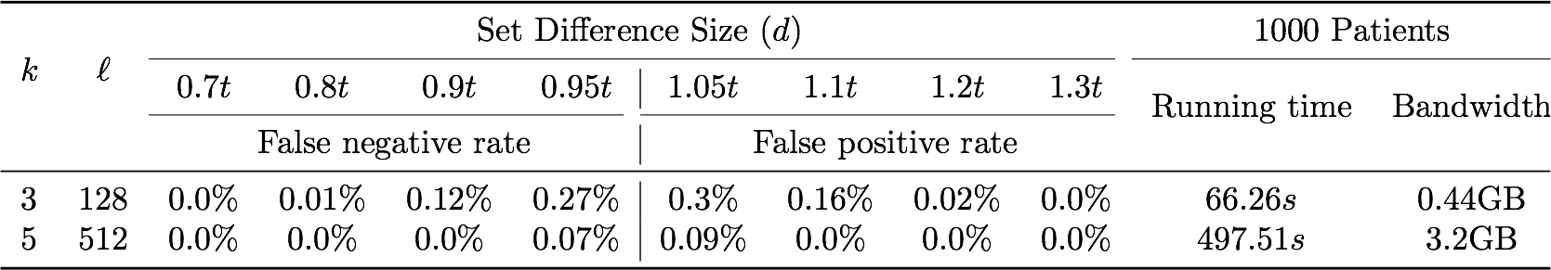
Thresholding Edit Distance

Slide 69



Classic Ideal Model
z
    z = DiffSize(A,B)
A
B

Slide 70
Our Modified Ideal Model
z, r
    z = SketchDiffSize(A,B,r)
A
B

Slide 71
Q & A

