Slide 1

Secure Computation Basics
Yan Huang
Indiana University
May 9, 2016

Slide 2

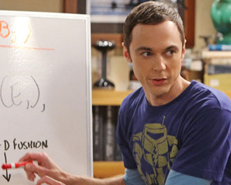
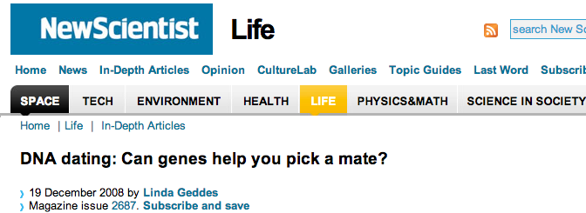

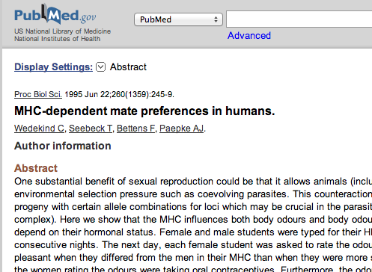


Dating: Genetically
Good match?

Slide 3
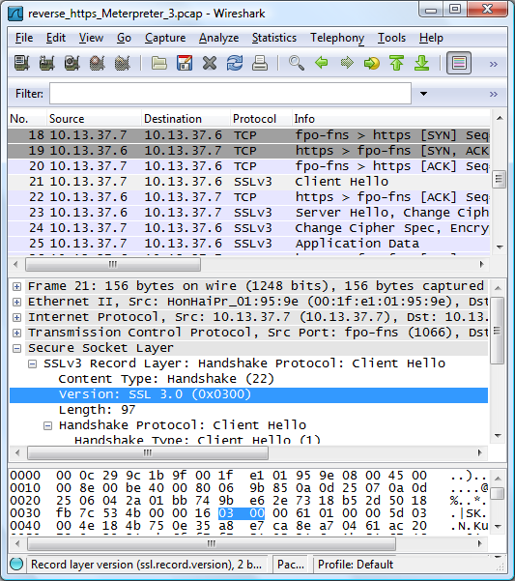







Internet Intrusion Detection
Detect suspicious traffic

Slide 4


Problem Abstraction
Alice
Public function f
Bob
Holds
Holds
z = f(x, y)
Security requirement:
Reveal z
but nothing more!

Slide 5

Ideally, with a Trusted Party

Slide 6
In the Real World
Secure computation enables this!
……
but nothing more!
but nothing more!

Slide 7
Secure Computation
Alice
Public function f
Bob
Holds
Holds
z = f(x, y)
Security requirement:
Reveal z
but nothing more!

Slide 8
What’s Out of the Scope
Leaking through the final results
Bad implementation of the protocol

Slide 9
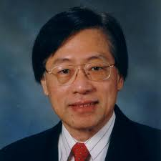
1980s
2012
Secure Computation [Yao, FOCS’82]
Yao’s Circuits
[Yao, FOCS’86]
Fairplay
[MNPS, USENIX’04]
Millionaire (x > y): 1 sec
Median of 20 numbers (16-bit)
:
7 sec

Slide 10


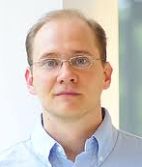

FastGC [HEKM, USENIX’11]
Edit Distance of 100-char strings:
4s
Secure Genomics [JKS, S&P’08]
100
1.5 m
2012
1980s
Secure Computation [Yao, FOCS’82]
Yao’s Circuits
[Yao, FOCS’86]
Fairplay
[MNPS, USENIX’04]
Millionaire (x > y): 1 sec
320μs
Median of 20 numbers (16-bit)
0.8ms
:
7 sec

Slide 11
Secure
Gaming
Private navigation
Time series analysis
Secure biometrics
Set intersection
Ridge regression
2011
today
Binary search
Neighborhood watch
Secure auction and voting
Zero-knowledge proof
Whole genome comparison

Slide 12
This Talk
Garbled Circuits
Oblivious Transfer and its Extension
Formal Definition of Security
Deal with Active Adversaries

Slide 13
A Binary Gate
Alice
Bob
(Evaluator)
x=0
0 NAND 0
y=0
A
B
NAND
Z
[Yao, FOCS’86]

Slide 14
A Binary Gate
Alice
(Generator)
Bob
(Evaluator)
a₀
A
a₁
B
NAND
a₀, a₁ are random bit strings
Z
[Yao, FOCS’86]

Slide 15
A Binary Gate
Alice
(Generator)
a₀
b₀
A
a₁
b₁
B
a₀, a₁, b₀, b₁, z₀, z₁ are independent random bit strings
NAND
Z
z₀
z₁
[Yao, FOCS’86]

Slide 16
A Binary Gate
Alice
(Generator)
a₀
b₀
keys
messages
A
a₁
b₁
B
NAND
Enc_{a0, b0}(z₁)
Enc_{a0, b1}(z₁)
Enc_{a1, b0}(z₁)
Enc_{a1, b1}(z₀)
Z
z₀
z₁
[Yao, FOCS’86]

Slide 17
A Binary Gate
Alice
(Generator)
a₀
b₀
A
a₁
b₁
B
AND
Enc_{a0, b0}(z₁)
Enc_{a0, b1}(z₁)
Enc_{a1, b0}(z₁)
Enc_{a1, b1}(z₀)
Z
z₀
z₁
[Yao, FOCS’86]

Slide 18
A Binary Gate
Alice
(Generator)
Bob
(Evaluator)
a₀
b₀
A
a₁
b₁
B
NAND
Enc_{a0, b0}(z₁)
Enc_{a0, b1}(z₁)
Enc_{a1, b0}(z₁)
Enc_{a1, b1}(z₀)
Z
z₀
z₁
[Yao, FOCS’86]

Slide 19
A Binary Gate
Alice
(Generator)
Bob
(Evaluator)
a₀
a₀
b₀
0 NAND 0
x=0
b₀
y=0
A
a₁
b₁
B
NAND
Enc_{a0, b0}(z₁)
z₁
Enc_{a0, b0}(z₁)
✔
z=0 NAND 0
=1
Enc_{a0, b1}(z₁)
Enc_{a0, b1}(z₁)
✗
Enc_{a1, b0}(z₁)
Enc_{a1, b0}(z₁)
✗
✗
Enc_{a1, b1}(z₀)
Enc_{a1, b1}(z₀)
Z
z₀
z₁
[Yao, FOCS’86]

Slide 20
A Leak
Alice
(Generator)
Bob
(Evaluator)
x=0
0 NAND 0
y=0
Alice’s input must be 0 since it’s the first row that can be decrypted.
a₀
b₀
Enc_{a0, b0}(z₁)
z₁
Enc_{a0, b0}(z₀)
✔
Enc_{a0, b1}(z₁)
Enc_{a0, b1}(z₀)
✗
Enc_{a1, b0}(z₁)
Enc_{a1, b0}(z₀)
✗
✗
Enc_{a1, b1}(z₀)
Enc_{a1, b1}(z₁)
[Yao, FOCS’86]

Slide 21
Prevent the Leak
Alice
(Generator)
Randomly Permute
Enc_{a0, b0}(z₁)
Enc_{a0, b1}(z₁)
Enc_{a1, b0}(z₁)
Enc_{a1, b1}(z₀)
[Yao, FOCS’86]

Slide 22
Prevent the Leak
Alice
(Generator)
Bob
(Evaluator)
a₀
b₀
Enc_{a1, b1}(z₀)
Enc_{a1, b1}(z₀)
✗
Enc_{a1, b0}(z₁)
Enc_{a1, b0}(z₁)
✗
Enc_{a0, b1}(z₁)
Enc_{a0, b1}(z₁)
✗
Enc_{a0, b0}(z₁)
Enc_{a0, b0}(z₁)
✔
[Yao, FOCS’86]

Slide 23
Transferring b₀ obliviously
Alice
(Generator)
Bob
(Evaluator)
b₀
y=0
Oblivious Transfer
b₁
b₀

Slide 24
Transferring b₀ obliviously
Alice
(Generator)
Bob
(Evaluator)
b₀
Oblivious Transfer
y
b₁
b_{y}
Output
[Naor-Pinkas, SODA’00]

Slide 25
Security of NPOT
Receiver’s Privacy
  h is uniformly random, independent of y
Sender’s Privacy
  Receiver cannot learn b_{y} as it doesn’t know log_{g}C
Output

Slide 26
Computing a Binary Gate
Alice
(Generator)
Bob
(Evaluator)
x=0
a₀
b₀
y=0
Oblivious Transfer
a₀
b₀
a₁
b₁
A
B
Enc_{a1, b1}(z₀)
✗
NAND
z=0 NAND 0
=0
Enc_{a1, b0}(z₁)
✗
Enc_{a0, b1}(z₁)
✗
Z
Enc_{a0, b0}(z₁)
z₀
✔
z₁
[Yao, FOCS’86]

Slide 27
Computing a Binary Gate
Alice
(Generator)
Bob
(Evaluator)
a₀
b₀
a₁
b₁
A
B
OR
Z
z₀
z₁
[Yao, FOCS’86]

Slide 28
Computing a Binary Gate
Alice
(Generator)
Bob
(Evaluator)
a₀
b₀
a₁
b₁
A
B
Enc_{a1, b1}(z₁)
OR
Enc_{a1, b0}(z₁)
Enc_{a0, b1}(z₁)
Z
Enc_{a0, b0}(z₀)
z₀
z₁
[Yao, FOCS’86]

Slide 29
Generic Secure Computatoin
AND Gate 1
Enc_{c0, d1}(f₀)
Enc_{c1,d1}(f₁)
Enc_{c1,d0}(f₀)
Enc_{c0,d0}(f₀)
a
b
c
d
AND
AND
e
f
OR Gate 2
Enc_{e0, f1}(g₁)
Enc_{e1,f1}(g₁)
Enc_{e1,f0}(g₁)
Enc_{e0,f0}(g₀)
100000000000
OR
O(n)
g
…
We can do any computation privately this way!
[Yao, FOCS’86]

Slide 30
Important Optimizations
XOR can be free
OT can be extended
Two rows per gate is enough
  Using Half-Gates garbling (next lecture by Dave)

Slide 31
XOR can be (almost) Free
R←{0,1}^{n}
a₀
b₀
a₀
b₀
a₁ = a₀⊕R
b₁ = b₀⊕R
a₁ = a₀⊕R
b₁ = b₀⊕R
AND
XOR
c₀
c₀ = a₀⊕b₀
c₁ = c₀⊕R
c₁ = a₀⊕b₀⊕R
Inexpensive local computation only;
No encryption, No communication overhead.

Slide 32
OT can be Extended

Slide 33
Similar Goal, Different Efforts
Symmetric Encryption
(PRG, Hash)
Oblivious Transfer
?
Asymmetric encryption
Very cheap in practice (Easy to implement heuristically)
Orders of magnitude more expensive (Hard to implement heuristically)

Slide 34

Extending Expensive Primitives
m₁
m₂
black-box
⇐
m₁
m₂
+
m_{n}
m_{n}
Encryption
OT
OT
OT
OT
OT
OT
OT
OT
⇐
OT
OT
OT
OT
OT
OT
OT
+
OT
OT
OT
OT
OT
OT
OT
OT
OT
OT
OT
OT
OT
OT
OT
OT
OT
OT
OT
OT
OT
OT
OT
OT
OT
OT
OT
Oblivious Transfer

Slide 35
High-Level Idea
Sender
Receiver
k colomns
m_{1,s1}
m_{2,s2}
…
Oblivious Transfer
n
rows
m_{n,sn}

Slide 36
Sender: (m_{0,i}, m_{1,i}) _{0 ≤ i < n}
Receiver: s = s₀ , …, s_{n-1}
r ← {0,1}^{k}
T←{0,1}^{n×k}, T^{i}: i^{th} colomn T_{i}: i^{th} row
Matrix Q. Q_{i}: i^{th} row
r₀
r₁
r_{k-1}
T⁰
T⁰ ⊕ s
T¹
T¹ ⊕ s
T^{k-1}
T^{k-1} ⊕ s
Q_{i}=T_{i}
i^{th} row
if s_{i} = 0
Q_{i}=T_{i}⊕ r
i^{th} row
if s_{i} = 1
n
rows
…
…
Sender sends: (y₀, y₁) = (m_{i,0}⊕H(i, Q_{i}), m_{i,1}⊕H(i, Q_{i}⊕r)) _{0 ≤ i < n}
Receiver outputs: y₀ ⊕H(0, T_{i}), if s_{i}=0;
y₁ ⊕H(1, T_{i}), if s_{i}=1.
m_{1-si} remains hidden because receiver never knows T_{i}⊕r.

Slide 37
Do we really need a secure encryption scheme?
Enc_{a0, b0}(z₁)
Enc_{a0, b1}(z₁)
No, Secure garbling schemes suffice. More on this in Dave’s lecture later.
Enc_{a1, b0}(z₁)
Enc_{a1, b1}(z₀)

Slide 38
System Level Optimizations
Design efficient circuits
Use the right crypto protocols
Frugal Budgets
  use SC only when absolutely necessary
  Don’t waste any single bit at any time
Pipelined execution

Slide 39
What if the parties do not follow the protocol?
  Formalize the notion of security?
  Dealing with Active Adversaries?
Saved for tomorrow
Efficiently develop your favorite applications?
RAM model computation?

Slide 40


Modeling Adversaries
Honest-but-curious
Always follow the protocol but tries to learn extra from the execution transcripts
Malicious/Active
Absolutely no restriction on polynomial time adversaries

Slide 41
How to Define Security?
First attempt: breaking security into
  Correctness
    P₁ learns f₁(x,y)
    P₂ learns f₂(x,y)
  Privacy
    no leak of P₁’s x
    no leak of P₂’s y
Coin tossing: f(⋅,⋅)
{return rand();}
P: a one-way permutation
It satisfy the definition but is undesirable since Alice knows a hard-to-compute pre-image of r.
s ← {0,1}^{k}
r
r ← P(s)
output r
output r

Slide 42
Alice
(Sender)
Bob
(Receiver)
b₀
b₁
y
Sender’s Privacy
  Receiver cannot learn b_{y} as it doesn’t know log_{g}C
Output
[Naor-Pinkas, SODA’00]

Slide 43
Yao’s Protocol (Semi-Honest)
Alice
Bob
Garbled (encrypted) circuit
Compute f(x,y)
(learns nothing else)

Slide 44
Example Active Attacks
Garbled And Gate
Enc_{a0, b1}(x₀)
Enc_{a1,b1}(x₁)
Enc_{a1,b0}(x₀)
Enc_{a0,b0}(x₀)
a₀ or a₁
b₀ or b₁
AND
x₀ or x₁

Slide 45
Example Active Attacks
Garbled And Gate
Enc_{a0, b1}(x₀)
Enc_{a1,b1}(x₁)
Enc_{a1,b0}(x₀)
Enc_{a0,b0}(x₀)
a₀ or a₁
b₀ or b₁
AND
x₀ or x₁

Slide 46
Active adversaries can attack a protocol in any unexpected ways.
How to define security to anticipate future/unknown venues of attacks?

Slide 47
Ideal/Real Paradigm
x
y
x
y
f₁(x,y)
f₂(x,y)
output
output
f₁(x,y)
output
A protocol is secure if for every (efficient) real-world adversary,
there is an ideal-world adversary having an ‘equivalent’ effect.

Slide 48
What are effects?
x
y
x
x
y
y
f₁(x,y)
f₂(x,y)
output
output
f₁(x,y)
output
The Environment/observer

Slide 49

Coin tossing: f(⋅,⋅)
{return rand();}
In the Ideal/Real paradigm, we can actually prove the aforementioned coin-tossing protocol cannot be secure.
P: a one-way permutation
s ← {0,1}^{k}
r
r ← P(s)
output r
output r
f₁(x,y)
f₂(x,y)
s
r
?
r

Slide 50

Achieve Active Security
Solution: cut-and-choose

Slide 51

The Cut-and-choose Paradigm

Slide 52
The Cut-and-choose Paradigm

Slide 53
The Cut-and-choose Paradigm
Final output
Majority

Slide 54
Bound the Failures
  n --- total number of circuits
  e --- number of error circuits
  k --- number of circuits to check
  Traditional Cut-and-choose:
  Roughly 3s circuits needed to achieve s-bit security.
[Shen and Shelat, Eurocrypt 2011]

Slide 55
Additional Issues
(1) Input consistency among all evaluation circuits
x, y
(2) Input consistency between OT and circuit Generation
w^{yi}, w^{1-yi}
OT

Slide 56
Recent Advances
Suffices to ensure there is at least one good evaluation circuit generated by the adversary. s circuits can offer s-bit statistical security.
[Lindell, Crypto’13]
[AMPR, EUROCRYPT’14]

Slide 57
Cut-and-choose (Recent Advances)

Slide 58
Cut-and-choose (Recent Advances)

Slide 59
Cut-and-choose (Recent Advances)
Yes
Output f(x,y).
Consistent outcome?
No
Recover x then
output f(x,y).

Slide 60
Goal
If the evaluator learns both w₀ , w₁ , it learns x.
The evaluator learning any one of w₀ , w₁ doesn’t learn x.
Whatever binding mechanism is used, ensure no leakage through protocol deviation.
x
A
B
AND
Z
w₀
w₁
[AMPR, EUROCRYPT’14]

Slide 61
Public inputs: g, h
(g^{r}, g^{x}h^{r})
r, s = log_{g}h
x
A
B
(h₀ , h₁) such that
h₀+h₁= g^{s0}+g^{s1}
= g^{s} = h
(h₀ , h₁)
Learning s reveals x.
AND
Z
w₀
(h₀g^{w0}, h₁g^{w1})
w₁
Check: Evaluator verifies h₀+h₁= h and
(w₀ , w₁) matches (h₀g^{w0}, h₁g^{w1})
Evaluate: Generator sends s₀+w₀ and s₁+w₁
[AMPR, EUROCRYPT’14]

Slide 62
Recent Advances (2)
Even more efficient if done collectively. E.g., <7 duplicates for 40-bit security
Ongoing work: any duplication factor strictly larger than 2 is achievable if the circuit is sufficiently large; but 2 is impossible to achieve.
[Lindell-Riva, Crypto’14]
[HKKKM, Crypto’14]
[FJNNO, EUROCRYPT’13]

Slide 63
Q & A

