Slide 1
Course A201: Introduction to Programming
12/9/2010

Slide 2
Review – Part 3
File operations
Catch an exception/error

Slide 3
File operations
TO OPEN
text_file = open("read_it.txt", "r") or
text_file = open("read_it.txt", “w")
Variable text_file is a file object that can access the contents of the file
TO CLOSE
text_file.close()
After you open a file, always close it.

Slide 4
File operations
It is like you use notepad to read or edit the file yourself. First, you double click to open the file, then after you done, click the ‘x’ to close the file.

Slide 5
Access Modes
r: Read from a text file. If the file doesn’t exist, Python will complain with an error.
w: Write to a text file. If the file exists, its contents are overwritten (the original content will all be erased). If the file doesn’t exist, it’s created.
a: Append a text file. If the file exists, new data is appended to it. If the file doesn’t exist, it’s created.

Slide 6
Read from a file
File methods to read from a file:
read()
readline()
readlines()
seek() *

Slide 7
Read from a file
For example, there is a ‘read_it.txt’ file in the same directory of your .py file. And the content of the file:
Line 1
This is line 2
That makes this line 3
You opened it for ‘read’
text_file = open("read_it.txt", "r")

Slide 8
Read from a file – read()
Method read() can accept zero or one argument:
text_file.read()
text_file.read(5)
Zero input argument:
>>> print(text_file.read())
Line 1
This is line 2
That makes this line 3

Slide 9
Read from a file – read()
One input argument, read character by character:
>>> print(text_file.read(1))
‘L’
Line 1
This is line 2
That makes this line 3

Slide 10
Read from a file – read()
One input argument, read character by character:
>>> print(text_file.read(1))
‘L’
>>> print(text_file.read(1))
‘i’
Line 1
This is line 2
That makes this line 3

Slide 11
Read from a file – read()
One input argument, read character by character:
>>> print(text_file.read(1))
‘L’
>>> print(text_file.read(1))
‘i’
>>> print(text_file.read(5))
‘ne 1\n’
Line 1
This is line 2
That makes this line 3
‘\n’ newline is also one character

Slide 12
Read from a file – read()
One input argument, read character by character:
>>> print(text_file.read(1))
‘L’
>>> print(text_file.read(1))
‘i’
>>> print(text_file.read(5))
‘ne 1\n’
>>> print(text_file.read(2))
‘Th’
Line 1
This is line 2
That makes this line 3
This number indicates how many characters you read at once

Slide 13
Read from a file
From the above example, you can see that when python reads from a file, a position pointer will be kept.
Line 1
This is line 2
That makes this line 3

Slide 14
Read from a file
>>> print(text_file.read(2))
‘Li’
Line 1
This is line 2
That makes this line 3

Slide 15
Read from a file
>>> print(text_file.read(2))
‘Li’
>>> print(text_file.read())
‘e 1
This is line 2
That makes this line 3’
Line 1
This is line 2
That makes this line 3
read() gives you all the contents that you haven’t read in yet.

Slide 16
Read from a file
>>> print(text_file.read(2))
‘Li’
>>> print(text_file.read())
‘e 1
This is line 2
That makes this line 3’
>>> print(text_file.read(2))
‘’
Line 1
This is line 2
That makes this line 3
Since the cursor is already at the end, there is nothing left is the file that you haven’t read. So, when you use the method again, nothing will show up.

Slide 17
Read from a file – seek()**
After knowing the idea of this invisible cursor while Python is reading from a file, you actually can relocate this cursor any time you want:
seek(offsite, from)

Slide 18
Read from a file – seek()**
seek(offsite, from):
Offset: number of position to move
from: reference position from where to move
If from is set to 0
– use the beginning of the file as the reference position
If from is set to 1
– use the current position as the reference position
If from is set to 2
– the end of the file would be taken as the reference position.

Slide 19
Read from a file – seek()**
>>> print(text_file.read())
‘Line 1
This is line 2
That makes this line 3’
>>> print(text_file.read(2))
‘’
Line 1
This is line 2
That makes this line 3
Since the cursor is already at the end, there is nothing left is the file that you haven’t read. So, when you use the method again, nothing will show up.

Slide 20
Read from a file – seek()**
>>> text_file.seek(0,0)
0
print(text_file.read(2))
‘Li’
Line 1
This is line 2
That makes this line 3
From the beginning of the file, offset is 0, so read(2) will read 2 letters from position 0

Slide 21
Read from a file – seek()**
>>> text_file.seek(6,0)
0
>>> print(text_file.read(2))
‘\nT’
Line 1
This is line 2
That makes this line 3
From the beginning of the file, offset is 6, so read(2) will read 2 letters from position 6

Slide 22
Write into a file
text_file = open(“write_it.txt", “w")
If the file write_it.txt had already existed, it would have been replaced with a brand-new, empty file and all of its original contents would have been erased.
text_file = open(“write_it.txt", “a")
Append a text file. If the file exists, new data is appended to it. If the file doesn’t exist, it’s created. The original contents will NOT be erased.

Slide 23
Write into a file
File methods to write into a file:
write()
writelines()

Slide 24
Write into a file – write()
Example:
>>> outfile = open(“test2.txt”, ‘w’)
>>> outfile.write(“hi”)
>>> outfile.write(“first line”)
>>> outfile.write(“second\nline\n”)
>>> outfile.write(“bye”)
>>> outfile.close()
test2.txt becomes:
hifirst linesecond
line
bye
If you want to write strings on different lines, don’t forget add a ‘\n’ at the end.

Slide 25
Write into a file – writelines()
Example:
>>> outfile = open(“test2.txt”, ‘w’)
>>> lines = ["Line 1\n", "This is line 2\n", "That makes this line 3\n"]
>>> outfile.writelines(lines)
>>> outfile.close()
test2.txt becomes:
Line 1
This is line 2
That makes this line 3
Again, don’t forget add a ‘\n’ at the end of each line.

Slide 26
Catch an exception/error
Try and except block
try:
num = int(input("Enter a number:"))
except:
print("Something went wrong!")

Slide 27
Catch an exception/error
Output:
Enter a number: abc
Something went wrong!
Instead of getting an error, you handle the error in your own way.

Slide 28
Catch an exception/error
The ‘else’ part
try:
num = int(input("Enter a number:"))
except:
print("Something went wrong!")
else:
print(num*num)

Slide 29
Catch an exception/error
Output:
Enter a number: abc
Something went wrong!
Enter a number: 5
25

Slide 30
Catch an exception/error
The ‘else’ part
try:
num = int(input("Enter a number:"))
except:
print("Something went wrong!")
else:
print(num*num)
Codes in ‘else’ block will only be executed if there’s no error/exception.

Slide 31
Catch an exception/error
Example for reading from a file
try:
text_file = open(“read_it.txt", “r")
except:
print("Something went wrong in opening the file!")
else:
contents = text_file.read()
print(contents )
text_file.close()

Slide 32
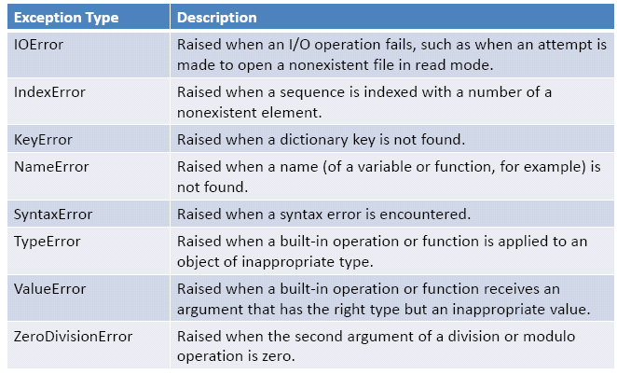
All types of Errors

