Slide 1
Course A201: Introduction to Programming
12/9/2010

Slide 2
Review – Part 2
Functions
Global variables vs local variables

Slide 3
Recall Function
[functions]
input1, input2, input3, …
You give me some inputs
I am a function.
I will perform a certain job.
I give you some outputs back, explicitly or implicitly
output1, output2, output3, …

Slide 4
Functions: define and call
def circle_area(radius):
return (3.14159 * radius ** 2)
circle_area(5)
print(“Now I know the area of the circle”)
This is the definition of a function. This block define what job will circle_area perform, input and output.
This is how you call the function: name and parentheses

Slide 5
Functions: define and call
def instructions():
print(“““Welcome to the greatest intellectual challenge of all time: Tic-Tac-Toe. This will be a showdown between your human brain and my silicon processor.”””)
instructions()
This is the definition.
This is how you call the function: name and parentheses

Slide 6
Functions: Return values
So, from the above two examples:
Function circle_area() does return a value, which is the area of a circle
Function instructions() does NOT return a value, and by default the return value will be None
The keyword return

Slide 7
Functions: Return values
You have two functions:
def circle_area1(radius):
area = 3.14159 * radius ** 2
return area
def circle_area2(radius):
area = 3.14159 * radius ** 2
print(area)

Slide 8
Functions: Return values
1) What’s the output of
print(circle_area1(5))
2) And, what’s the output of
print(circle_area2(5)))

Slide 9
Functions: Return values
1) What’s the output of
print(circle_area1(5))
2) And, what’s the output of
print(circle_area2(5)))
When a function doesn’t have a return statement in its definition, by default the return value will be None
78.53975
78.53975
None

Slide 10
Functions: Return values
Be careful with the requirement, if it tells you to write a function which return the value, then you need to write a return statement
It is always better to store the return value in a variable if the function has the return statement.
area = circle_area1(5)
print(area)
This is called: Catch the return value!

Slide 11
Parameters and Arguments
Parameters
def circle_area(radius):
return (3.14159 * radius ** 2)
circle_area(5)
print(“Now I know the area of the circle”)
Arguments

Slide 12
Parameters and Arguments
Parameters
def add(a, b):
return (a+b)
add(2, 4)
Arguments

Slide 13
Parameters and Arguments
Parameters are essentially variable names inside the parentheses of a function header:
add(a,b), a and b are parameters of the function add
You can have 0, 1 or many parameters
The function receives values/arguments through its parameters e.g. add(1,2)
The code in the function add now treats a and b as variables with values 1 and 2

Slide 14
Parameters and Arguments
Example from the final practice:
def newYearGreeting(name= "None", year= 2010):
print("Happy New Year,", name, "!", "It is", year, "!\n")

Slide 15
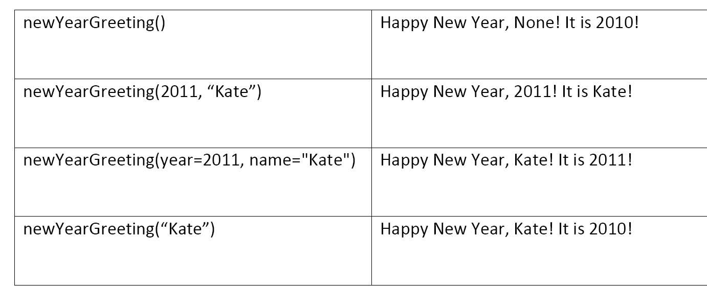
Parameters and Arguments
Example from the final practice:

Slide 16
Parameters and Arguments
Once you assign a default value to a parameter in the list, you have to assign default values to all the parameters listed after it.
So, this function header is perfectly fine:
def monkey_around(bananas = 100, barrel_of = "yes"):
But this isn't:
def monkey_around(bananas = 100, barrel_of):
The above header will generate an ERROR.

Slide 17
Global variables
Global variables: variables that are initialized in the main script
Local variables: variables that are initialized in the definition of a function

Slide 18
Global variables
def my_function():
value = 1
print(“In the local scope, value is”, value)
value = 10
print(“In the global scope, value is”, value)
Two ‘value’s have the same names, but they don’t refer to the same variable
Local variable
Global variable

Slide 19
Global variables
If you have a family friend named Bill Clinton. While in your neighborhood, ‘Bill Clinton’ refers to this friend by default. But out of your neighborhood, ‘Bill Clinton’ refers to the formal president by default.

Slide 20
Global variables
def my_function1():
value = 1
print(“In my function 1, value is”, value)
def my_function2():
print(“In my function 2, value is”, value)
value = 10
print(“In the global scope, value is”, value)
Local variable or global variable?

Slide 21
Global variables
def my_function1():
value = 1
print(“In my function 1, value is”, value)
def my_function2():
print(“In my function 2, value is”, value)
value = 10
print(“In the global scope, value is”, value)
This is a global variable.

Slide 22
Global variables
So, if there is an assignment statement, such as value = 1, in the definition of your local function, this value will be automatically considered as you create a new variable in your function, with the same name, but refers to a different value. This variable has nothing to do with the global one.
But if there is no assignment statement in your local function, as the above example, it will be considered as you are referring to the global variable
The ‘nearest’ policy

Slide 23
Global variables
Then, how to change a global variable in your local function?
Use the keyword: global
Compare two examples

Slide 24
Global variables
def my_function():
value = 1
value = 10
print(“At first, value is”, value)
my_function()
print(“Now, value is”, value)
Output:
At first, value is 10
Now, value is 10

Slide 25
Global variables
def my_function():
global value
value = 1
value = 10
print(“At first, value is”, value)
my_function()
print(“Now, value is”, value)
Output:
At first, value is 10
Now, value is 1
You explicitly declare this is a global variable

Slide 26
Global variables
To sum up:
Situation 1:
def my_function():
value = 1
print(“In my function 1, value is”, value)
value = 10
my_function()
print(“In the global scope, value is”, value)
This is a local variable.
They are different.

Slide 27
Global variables
To sum up:
Situation 2:
def my_function():
print(“In my function 1, value is”, value)
value = 10
my_function()
print(“In the global scope, value is”, value)
This is a global variable.
Both of them refer to the same variable.

Slide 28
Global variables
To sum up:
Situation 3:
def my_function():
global value
value = 1
print(“In my function 1, value is”, value)
value = 10
my_function1()
print(“In the global scope, value is”, value)
They now refer to the same variable, because you used the key word global.
Global ‘value’ is changed to 1.

